Slide 1

NBN SINHGAD SCHOOL OF ENGINEERING, AMBEGAON
Pune 411041
Goal Line Technology
Student Name | Roll No
Digambar Gavhane | T151053008
Vishal Nivangune | T151053029
Pankaj Ghodke | T151053009

Slide 2
INTRODUCTION
The objective of goal-line technology (GLT) is not to replace the role of the officials, but rather to support them in their decision-making.
The technology must provide a clear indication as to whether the ball has fully crossed the line, and this information will serve to assist the referee in taking his final decision. As well as it ensures a fair play in sports such as football, hockey, hand-ball and also removes the human errors in umpiring and decision making.
In football, there are some instances when the Ball hits the post, crosses the line but goes unnoticed due to human errors by referees.
To avoid this situation, we introduce a circuit that will detect whether the ball crosses the line or not using the concept of a sensing and detecting.
Apart from Football, this technology can be used in other sports as well. Also, with some modifications, it can be used in Traffic sensing and Home security, Vehicle counting on tollbooths as well as counting no of products on the assembly-line.

Slide 3
ABSTRACT
The goal-line technology is a method used to determine when the ball has slightly crossed the goal line with the assistance of electronic devices and at the same time assisting the referee in awarding a goal or not.
Aim of goal- line technology is to assist the match officials in decision-making rather than replacing them.

Slide 4
Block Diagram

Slide 5
Hardware used
IR Sensor
Voltage Regulator
LCD Display
Microcontroller
(PIC18F4520)
Buzzer

Slide 6
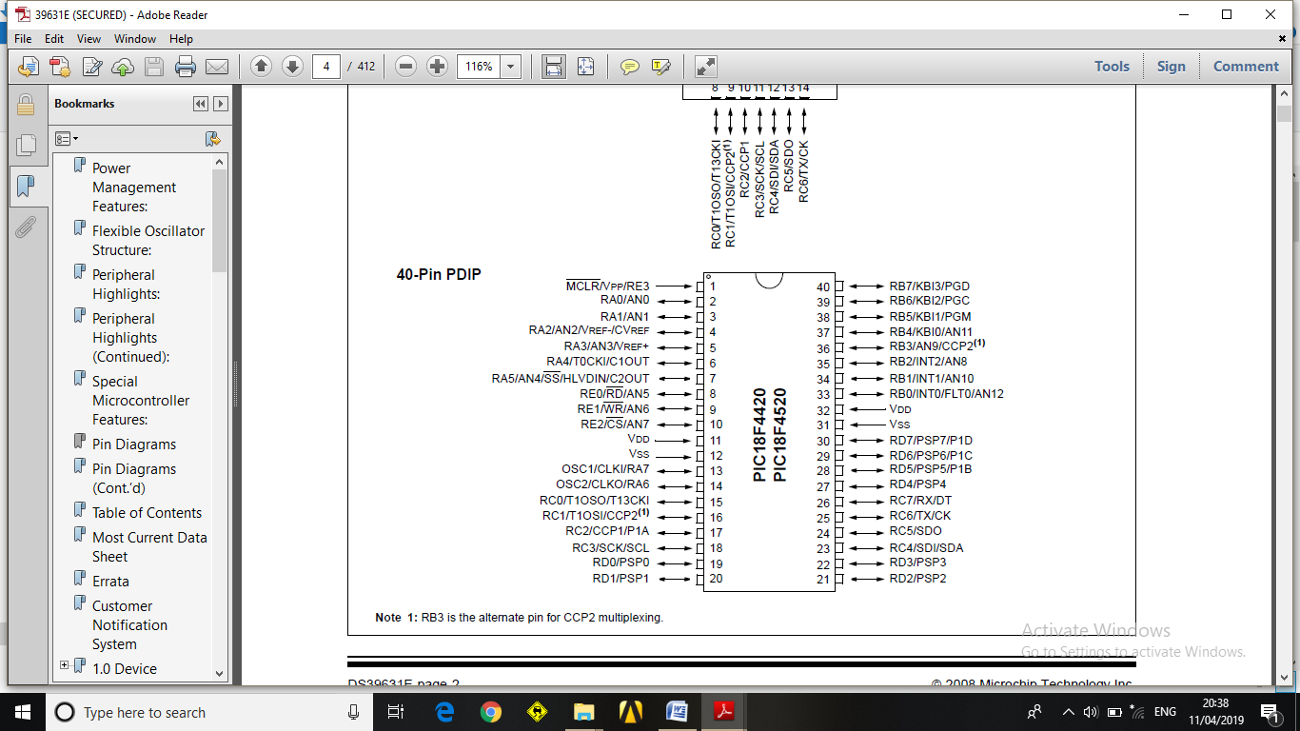
PIC18F4520 Microcontroller
40 Pin Microcontroller
Low Cost
Low Power High Speed
Fully Static
8 Bit Microcontroller

Slide 7
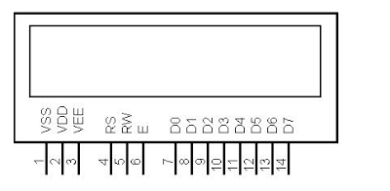
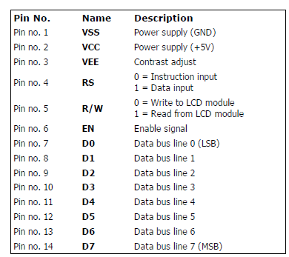
LCD (Liquid Crystal Display)

Slide 8
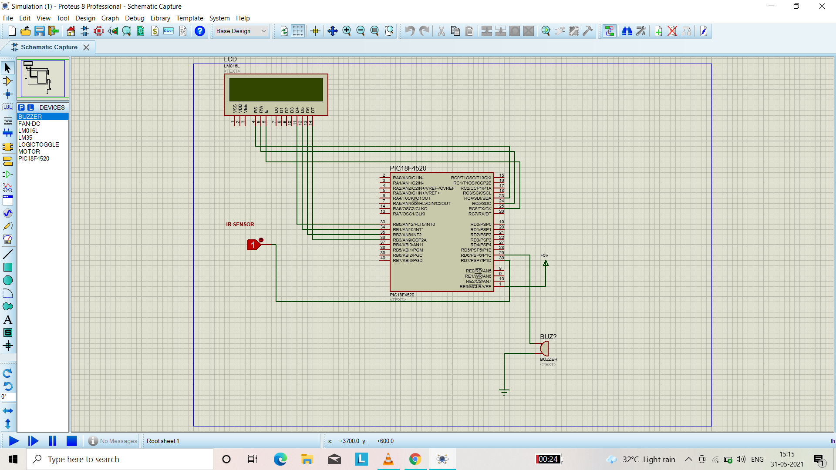
Proteus Schematic Diagram
Simulation

Slide 9
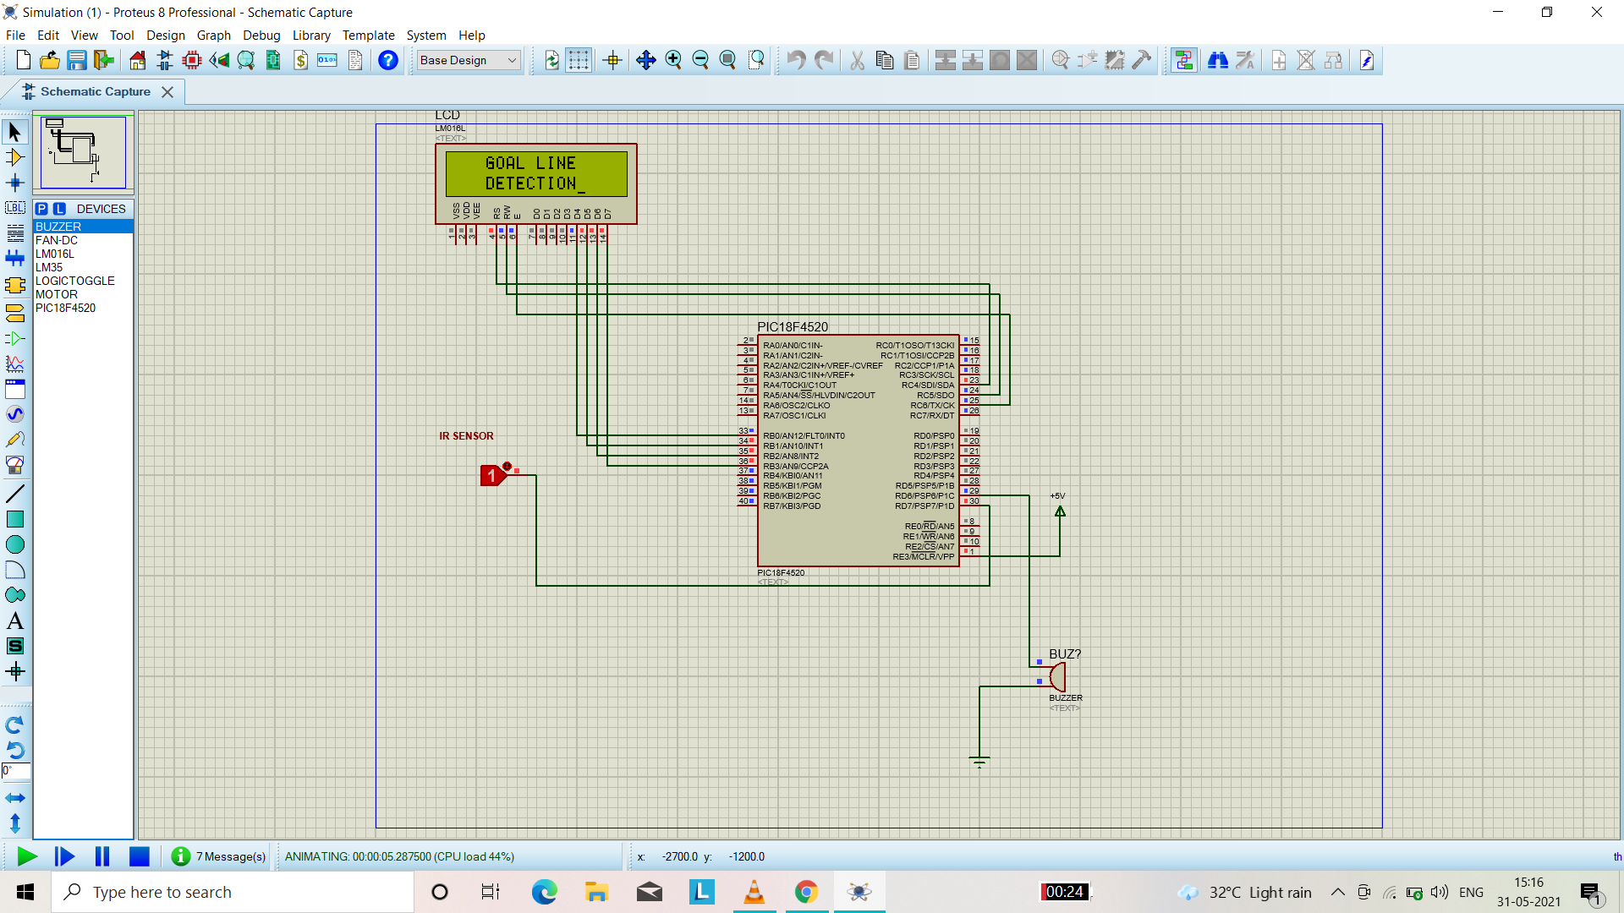
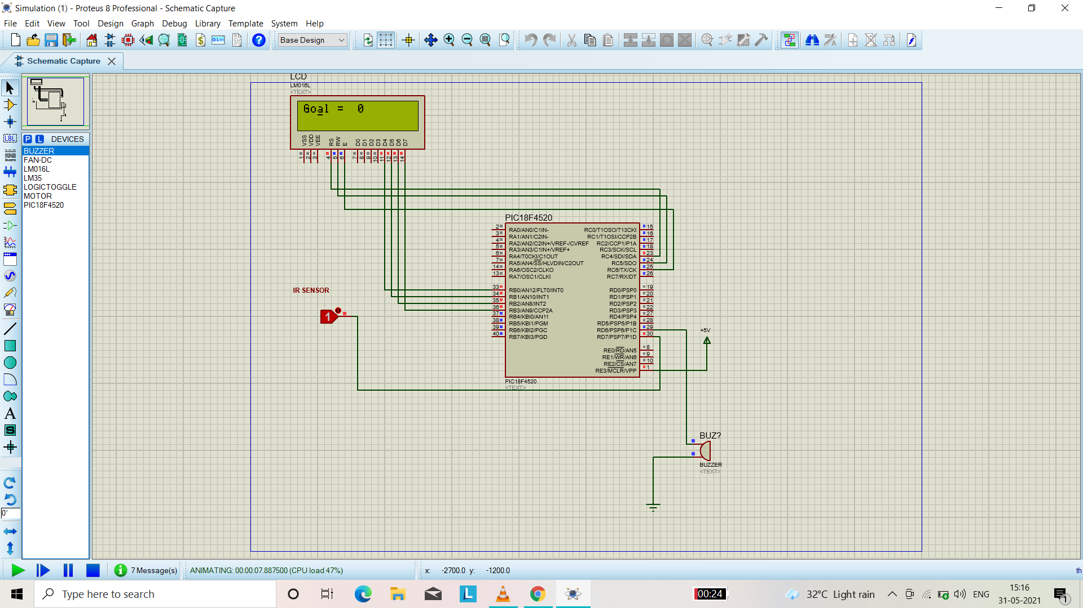

Slide 10
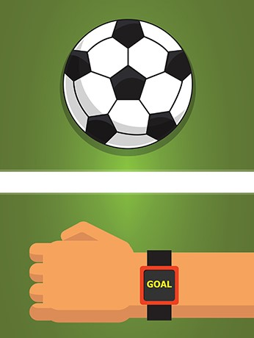
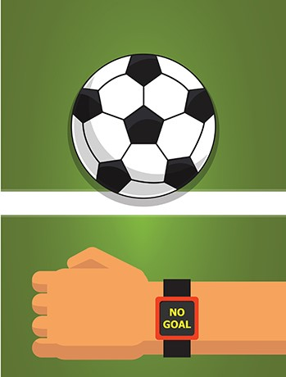
Sensor Indicating
Goal Detected
Sensor Indicating
Goal Not
Detected

Slide 11
Software used
1 . Eagle
(Easily Applicable Graphical Layout Editor )
(Used for PCB Design)
2 . Proteus Design Suite
(Use For Creating Schematic Diagram And Simulation of circuit )
3 . MPLAB
(Use to develop code for embedded microcontroller)

Slide 12
Applications
Football League
Hockey

Slide 13
Advantages
Reduction of errors in awarding a goal.
Accuracy
It can count objects.

Slide 14
Disadvantage
It can not replace match officials ,it can only assist them.
Technology is not 100% accurate

Slide 15
Thank You !!

